Slide 1

TOOLS FUND
Saving Toward the Shop
Where the fund stands and where it is headed
A personal plan by Jordan Thomas McDaniel

Slide 2
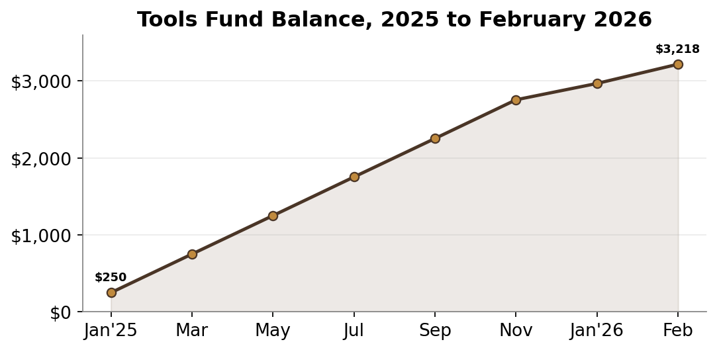
TODAY
The Fund at a Glance
Balance, Feb 2026
Monthly in
General savings
Debt
$3,218
$250
$200 / mo
$0
One tool order in November 2025 dipped the balance, then it climbed right back. The fund is sacred. Eating out gets skipped before a contribution does.
Tools fund and savings plan
Confidential

Slide 3
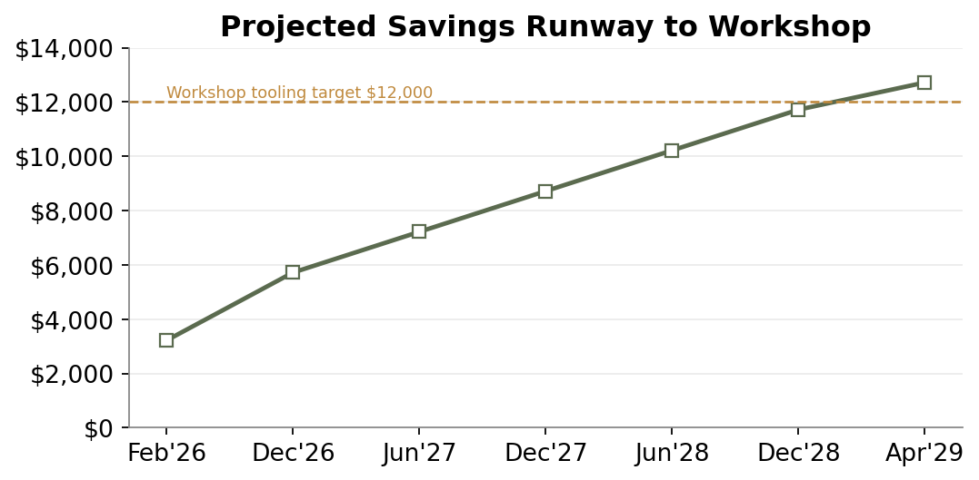
AHEAD
Savings Runway
Checkpoint | Balance
December 2026 | $5,718
June 2027 | $7,218
December 2027 | $8,718
June 2028 | $10,218
April 2029 | $12,718
Tools fund and savings plan
Confidential

Slide 4
WISHLIST
Tools to Buy, In Order
Tool | Why | Target price | Priority
No. 7 jointer plane | Flatten long edges by hand | $475 | Next up
Router table setup | Cleaner joinery and profiles | $350 | After that
Better dust collection | Keep the garage breathable | $200 | Soon
Cabinet saw fund | The big one, for the shop | Saving | Long term
Rule of the fund: nothing at or above $75 gets bought without checking the budget first.
Tools fund and savings plan
Confidential

